Slide 1
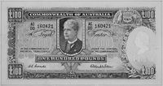
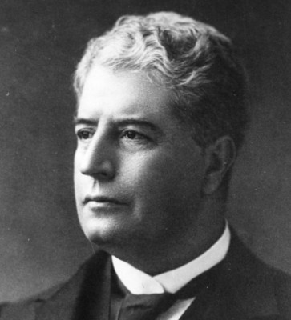
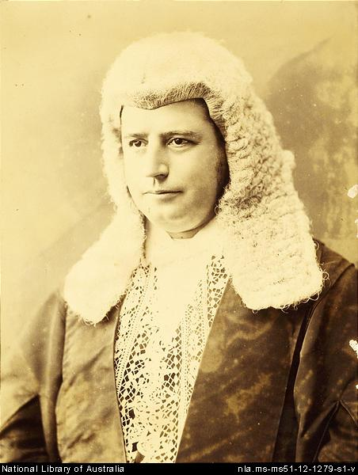
Edmund Barton

Slide 2
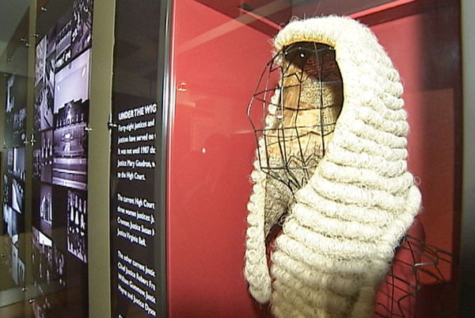
What did he do
Edmund Barton became prime mister on New Years Day in 1901. He had plenty of expertise in parliament: he’d been member of the N.S.W parliament for 20 years and served terms as speaker of it’s legislative assembly, attorney- general and leader of the opposition. He only served as prime minster for 2 years. He was the second Australian to receive the GCMG which is the highest knighthood available in the empire.
Barton worked on the federation for ten years and became Australia's first prime mister because they trusted him.

Slide 3
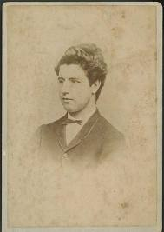
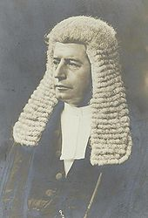
When was he born and how did he die
Edmund Barton was born in Glebe New South Wales on 18th of January 1849 and he suddenly died of a heart attack in 1920.

Slide 4
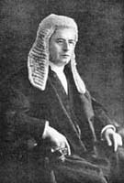
How did he improve Australia
Edmund Barton was the first prime minster of Australia. Apart from being Australia first prime mister Edmund Barton created the Federal Arbitration court and the high court of Australia of which he was founding justice. After he retired from politics in 1903 he became a high court judge.

Slide 5
links
http://en.wikipedia.org/wiki/ http://primeministers.naa.gov.au/primeministers/barton/fast-facts.aspxdmund_Barton
By Dainton

