Slide 1
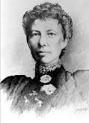
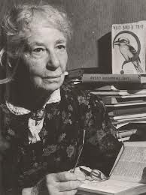
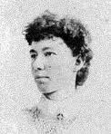
Dame Mary Jean Gilmore
By Jada Ngan-Woo
5/6C 2012

Slide 2
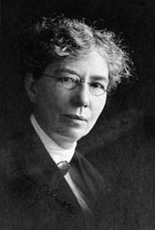
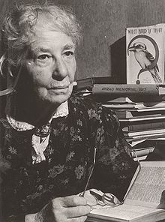
Dame Mary jean Gilmore
Mary in 1927.
Mary at age 83.

Slide 3
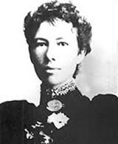
Early years
Mary lived near Goulbourn, New South Wales. She was born on the 16th August 1865 at Cotta Walla. Her heritage is Scottish and Irish her religion is Presbyterian. Sadly Mary died on the 3rd December 1962, aged 97. Mary was accorded to a writer since the death of Henry Lawson in 1922. Mary’s religion is Presbyterian.

Slide 4
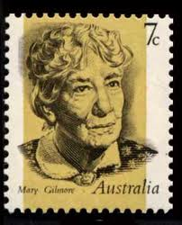
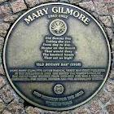
Career
Mary was a poet and journalist. Mary wrote many wonderful and inspirational poems. She was also a school teacher, socialist, essayist, utopian, columnist, auto biographer and pacifist. Mary was very talented and had lots of social skills.

Slide 5
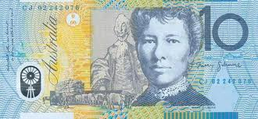
Achievements
During World War 2 Mary wrote stirring patriotic verses such as ‘No Foe Shall Gather Our Harvest’ . 25 years ago actor Beverly Dunn created a memorable portrait of the dame on the ten-dollar note:

Slide 6
Mary’s contribution
Mary’s first volume of poetry was published in 1910, and for the ensuring half-century. She was regarded as one of Australia’s most popular and widely read poets. In 1908 she became women's editor of The Worker, the newspaper of Australia's largest and most powerful trade union, the Australian Workers' Union (AWU). She was the union's first woman member. The Worker gave her a platform for her journalism, in which she campaigned for better working conditions for working women, for children's welfare and for a better deal for the indigenous Australians.

Slide 7
Bibliography
http://en.wikipedia.org/wiki/Mary_Gilmore
http://www.middlemiss.org/lit/authors/gilmorem/gilmorem
http://www.middlemiss.org/lit/authors/gilmorem/gilmore.
http://www.artgallery.nsw.gov.au/collection/works/OA28.1960/
http://www.ariahparkfestival.com/about-marygilmore.html

