Slide 1
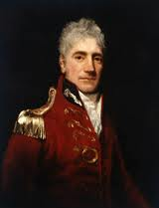
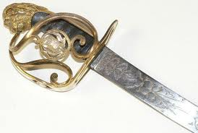
Lachlan Macquarie

Slide 2
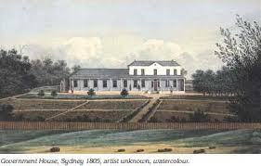
Lachlan’s life before Australia
Lachlan Macquarie was born in Ulva, Inner Hebrides
Lachlan Macquarie was born on 31st of the 1st 1762 and died in London, England in the UK on 1st of the 7th 1824 aged 62 in Scotland.

Slide 3
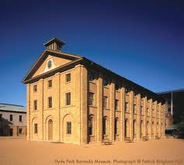
His involvement
He was the first to see above the limits of the convict settlement or the opportunities for self-enrichment which had characterised the early colony.
His vision, by 1821, was shown in a public building and town planning program that had established a solid infrastructure for the colony.

Slide 4
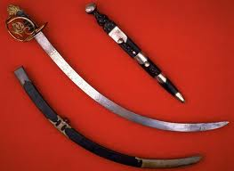
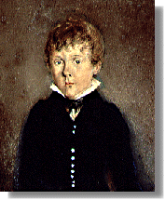
Lachlan Macquarie’s family
Macquarie's mother, Margaret, was the only sister of Murdoch Maclaine, chieftain of Lochbuy in Mull, and as a widow she farmed her pedicle of Oskamull, with her eldest son Donald and Farquhar Marcaine, until her death in 1810 at 82 years.
This is the Macquarie family swords

Slide 5
Links
http://adb.anu.edu.au/biography/macquarie-lachlan-
24http://adb.anu.edu.au/biography/macquarie-lachlan-
24191http://www.macquarie.com.au/mgl/au9

