Slide 1
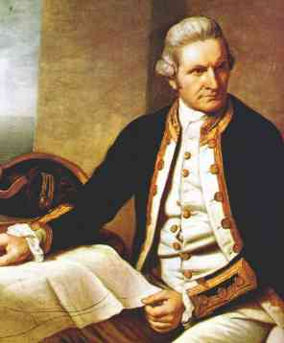
CAPTAIN JAMES COOK
British Explorer

Slide 2
His life
James Cook was born on October 27, 1728 in Main-Cleveland in the North Riding of Yorkshire. His birthplace was a thatched cottage. In 1736 the Cooks moved from there land to Farm in Ayton.
Unlike the majority of Naval officers of the time he was not the son of rich or noble parents. In fact he was the son of a Scottish farm labourer and a Yorkshire girl. He was intelligent enough to impress his father's employer who paid for the young James Cook's schooling.

Slide 3
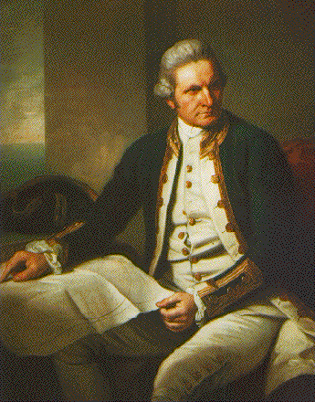
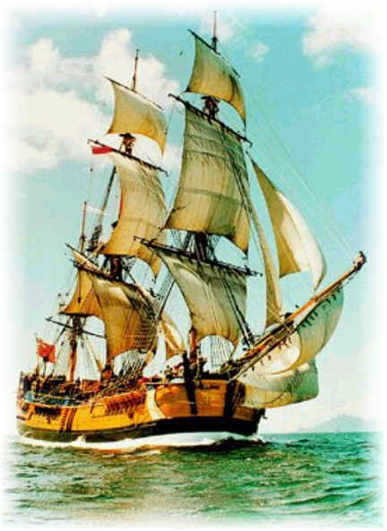
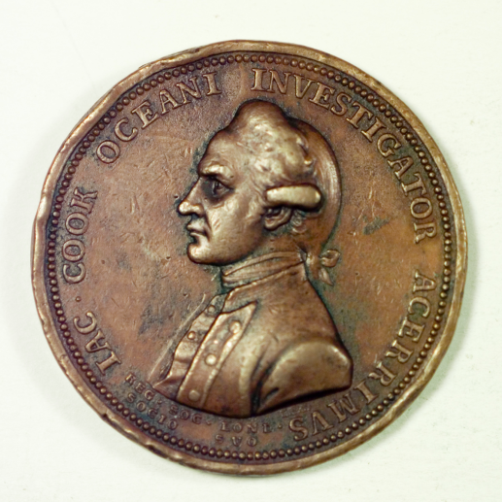
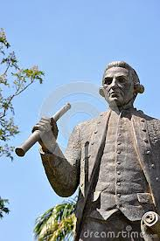
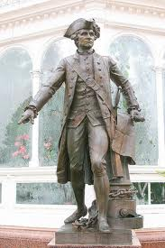
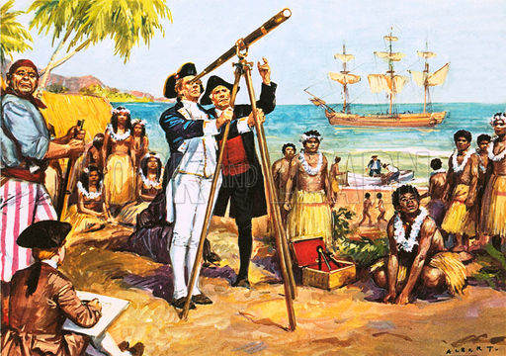
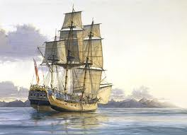
photos

Slide 4
After a month's stay, under sail again to resume his exploration of the Northern Pacific. Shortly after leaving Hawaii Island, the foremast of the Resolution broke and the ships returned to Kealakekua Bay for repairs. It has been hypothesised that the return to the islands by Cook's expedition was not just unexpected by the Hawaiians, but unwelcome, because the season of Lono had recently ended.
James Cook’s Death

Slide 5
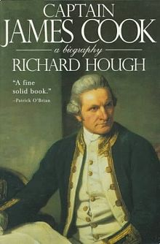
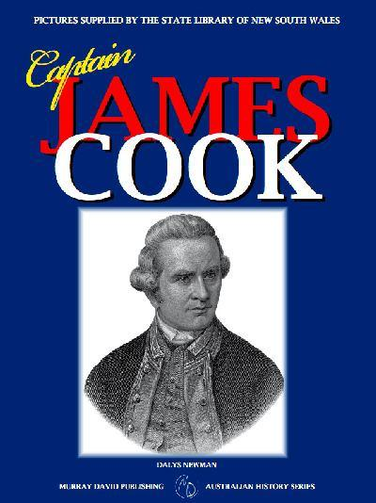
His books

Slide 6
Facts
Cook was an 18th century explorer and navigator whose achievements in mapping the Pacific, New Zealand and Australia radically changed western perceptions of world geography. As one of the very few men in the 18th century navy to rise through the ranks, Cook was particularly sympathetic to the needs of ordinary sailors.

Slide 7
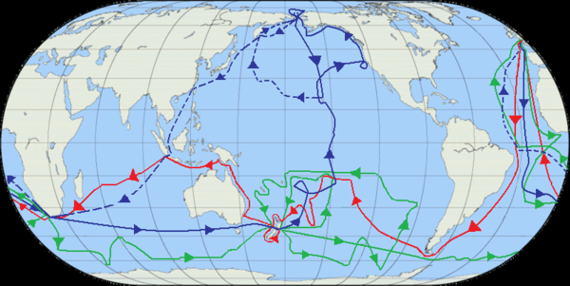
Where he travelled

Slide 8
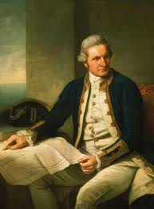
Why I think he is important
I think Captain James Cook is important because he was the first one to discover Australia and he never gave up on what he was trying to do. Did
You know James cook
wasn’t always the captain
he was just the one who
Cleaned the cabins but he
Kept getting promoted and he
Became captain

Slide 9
Bibliography
http://www.google.com.au/imgres?q=captain+james+cook+maps&hl=en&safe=active&sa=X&biw=1440&bih=809&tbm=isch&prmd=imvnso&tbnid=JTPk3UPwHo2dkM:&imgrefurl=http://www.enotes.com/topic/James_Cook&imgurl=http://wiki-images.enotes.com/thumb/4/4a/Cook_Three_Voyages_59.png/600px-Cook_Three_Voyages_59.png&w=600&h=301&ei=wMc6ULugMKmhiAeP_IDABg&zoom=1&iact=hc&vpx=427&vpy=318&dur=545&hovh=159&hovw=317&tx=125&ty=89&sig=116528322850980466717&page=1&tbnh=93&tbnw=186&start=0&ndsp=26&ved=1t:429,r:8,s:0,i:98
http://www.google.com.au/imgres?q=captain+james+cook+maps&hl=en&safe=active&sa=X&biw=1440&bih=809&tbm=isch&prmd=imvnso&tbnid=JTPk3UPwHo2dkM:&imgrefurl=http://www.enotes.com/topic/James_Cook&imgurl=http://wiki-images.enotes.com/thumb/4/4a/Cook_Three_Voyages_59.png/600px-Cook_Three_Voyages_59.png&w=600&h=301&ei=E8o6UMDMMquViQebg4HoCQ&zoom=1
http://www.captaincooksociety.com
http://en.wikipedia.org/wiki/James_Cook
http://www.winthrop.dk/cooklife.html
http://en.wikipedia.org/wiki/James_Cook
http://www.captaincooksociety.com/
/

