Slide 1
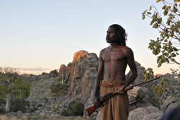
Jandamarra
By Taleisha
2012
5/6C

Slide 2
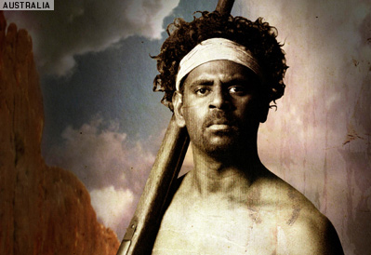
JANDAMARRA

Slide 3
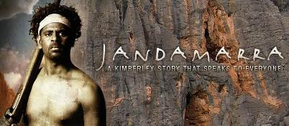
Where was he from?
He was from the Kimberly Western Australia\
[These are not real photos of Jandamarra]

Slide 4
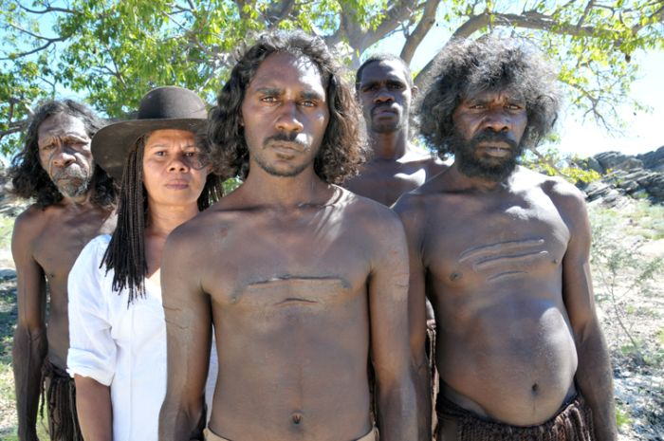
When was he born and when did he die ?
He was born in1873.He died in 1897.

Slide 5
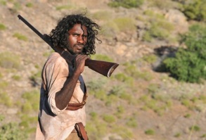
What did he do?
He was an outlaw in the 1980s he broke the laws when he was trying to defend the rights of his people.

Slide 6
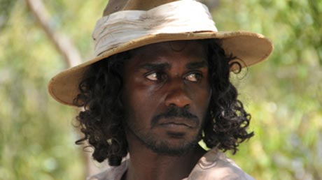
Why are his achievements important?
It is important to remember that it was Aboriginals’ land before the Europeans arrived.

Slide 7
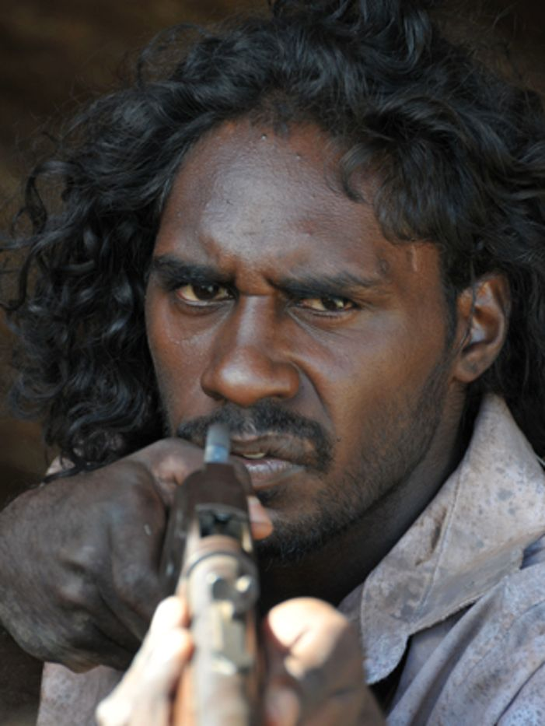
How did he improve Australia?
He tried to improve Australia but he couldn’t.

Slide 8
bibliography
http://www.kimberleyaustralia.com/story-of-jandamarra.html
www.jandamarra.com.au/jandamarratheman.htm
www.abc.net.au/tv/programs/jandamarraswar.htm
en.wikipedia.org/wiki/Jandamarra

