Slide 1
5 / 6 F Art
Artwork inspired by Jon Coburn’s tapestry designs

Slide 2
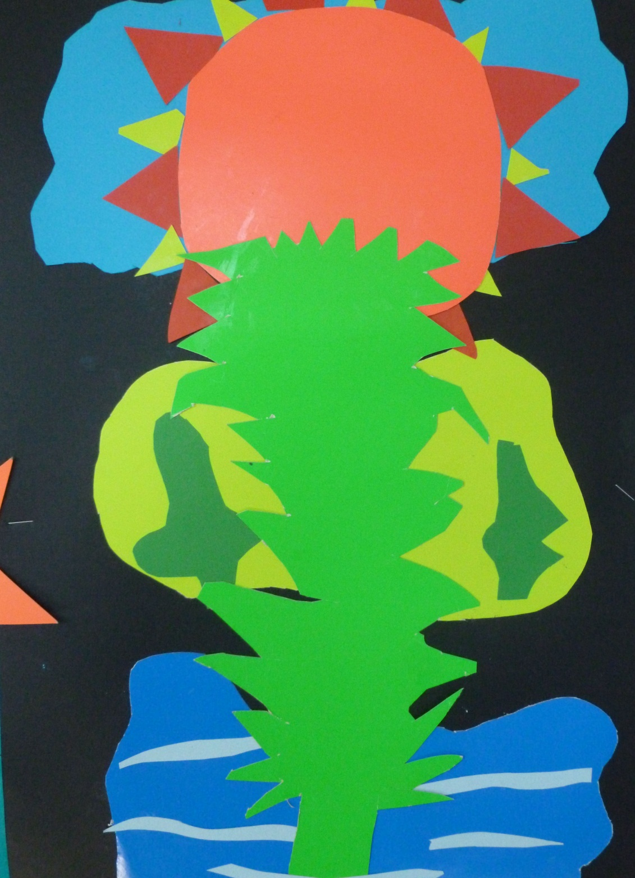
Vanessa

Slide 3
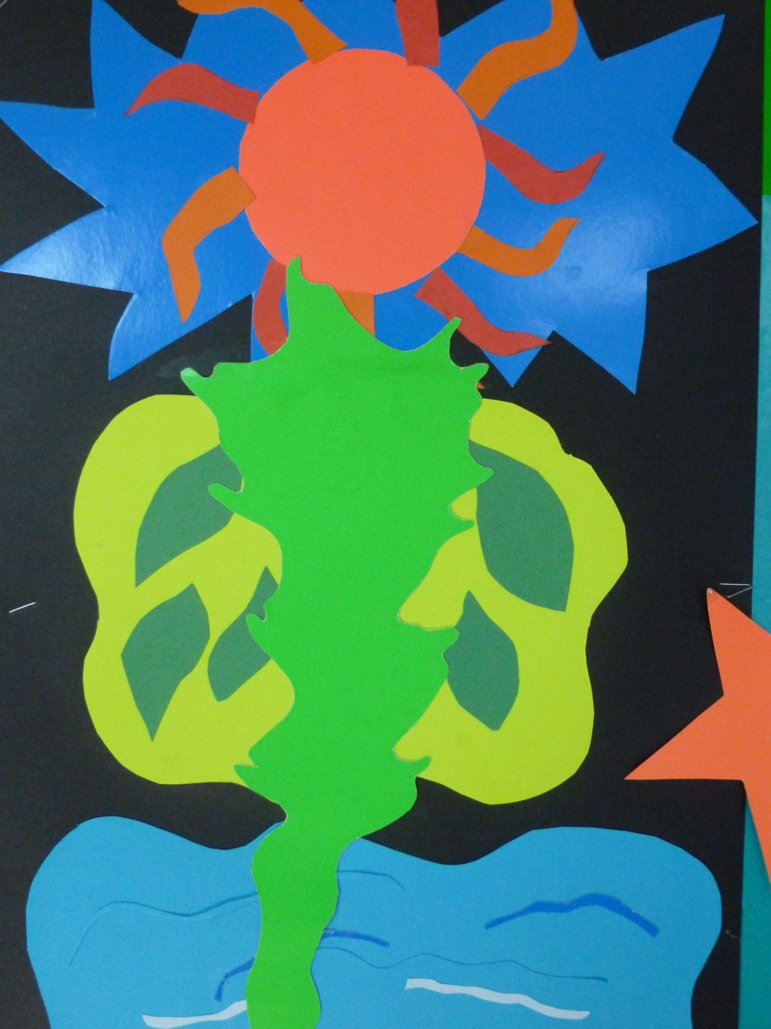
Hayley

Slide 4
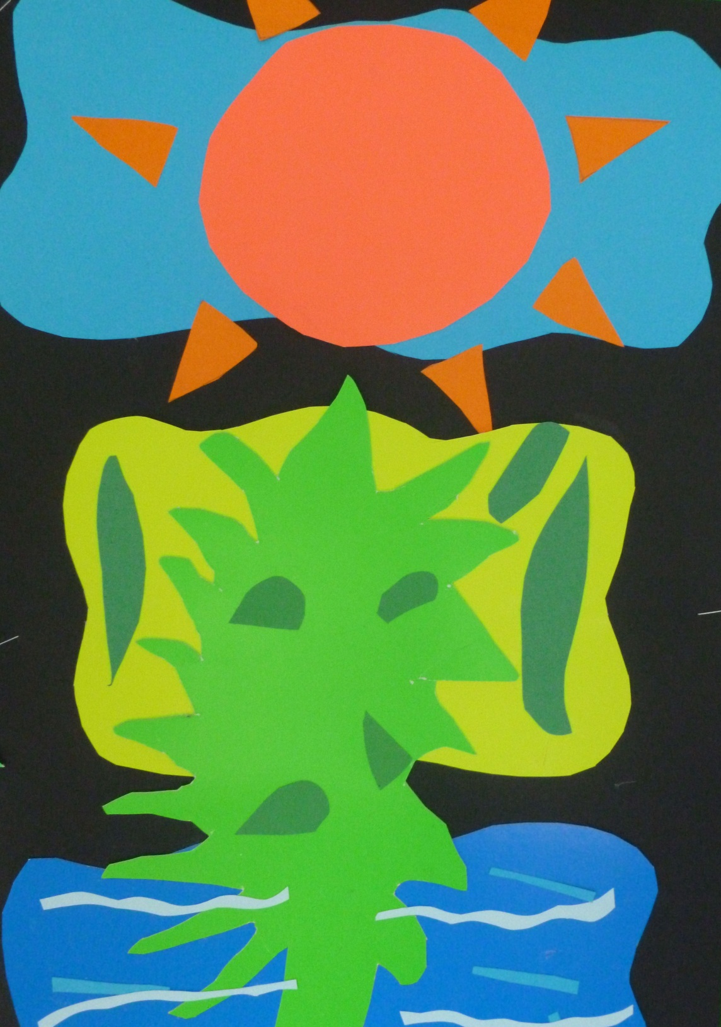
Kaylah

Slide 5
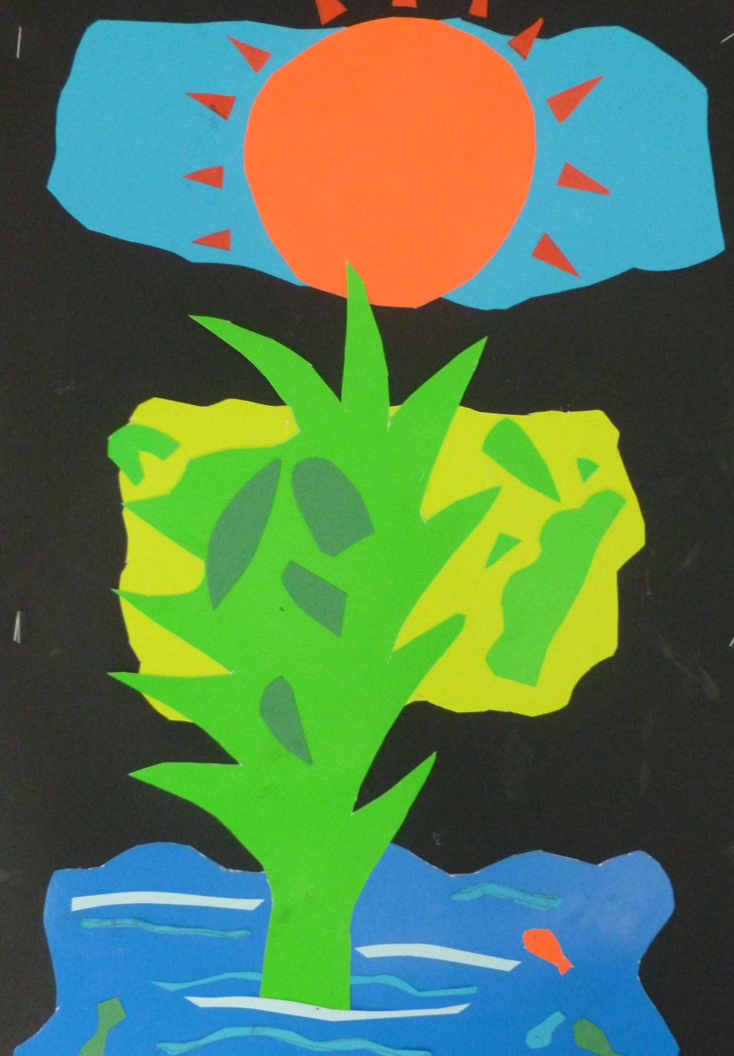
Gemma

Slide 6
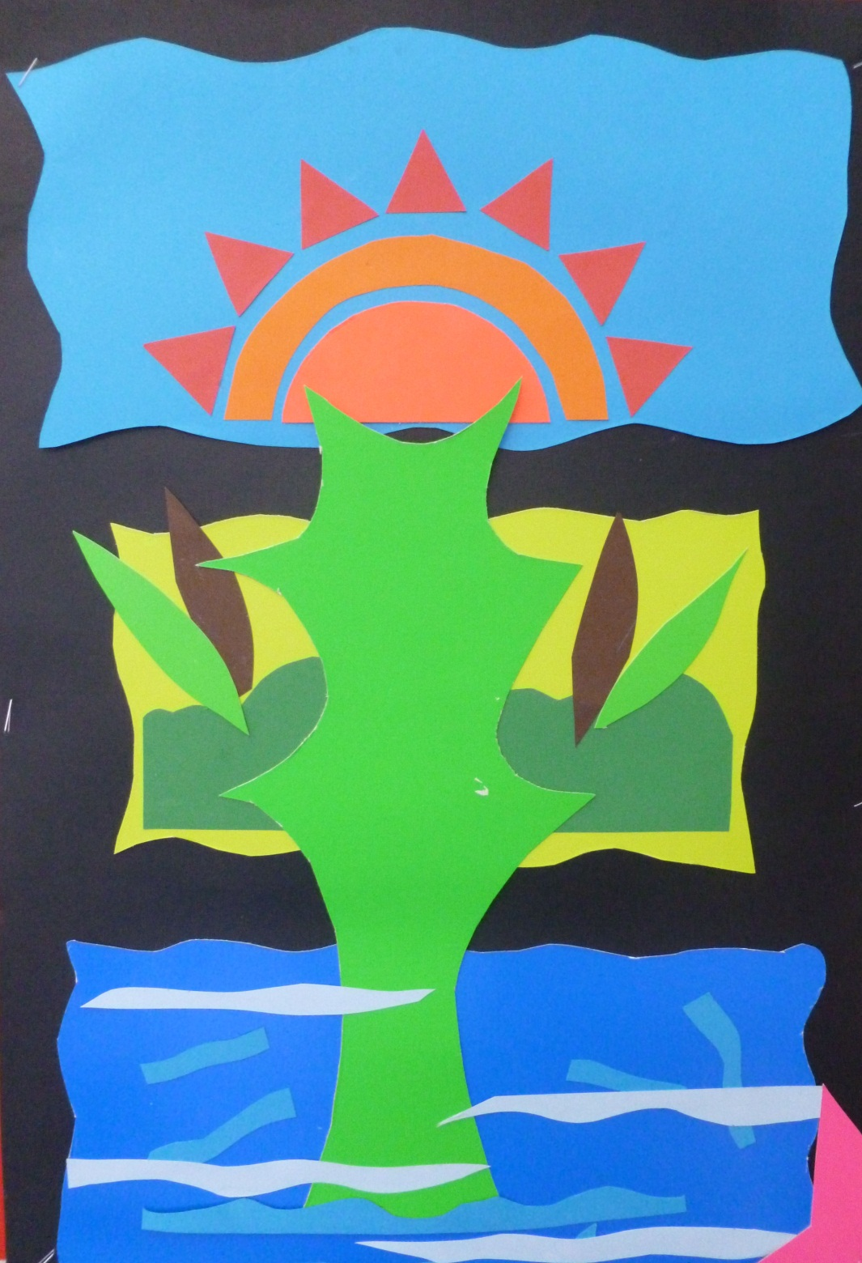
Ella

Slide 7
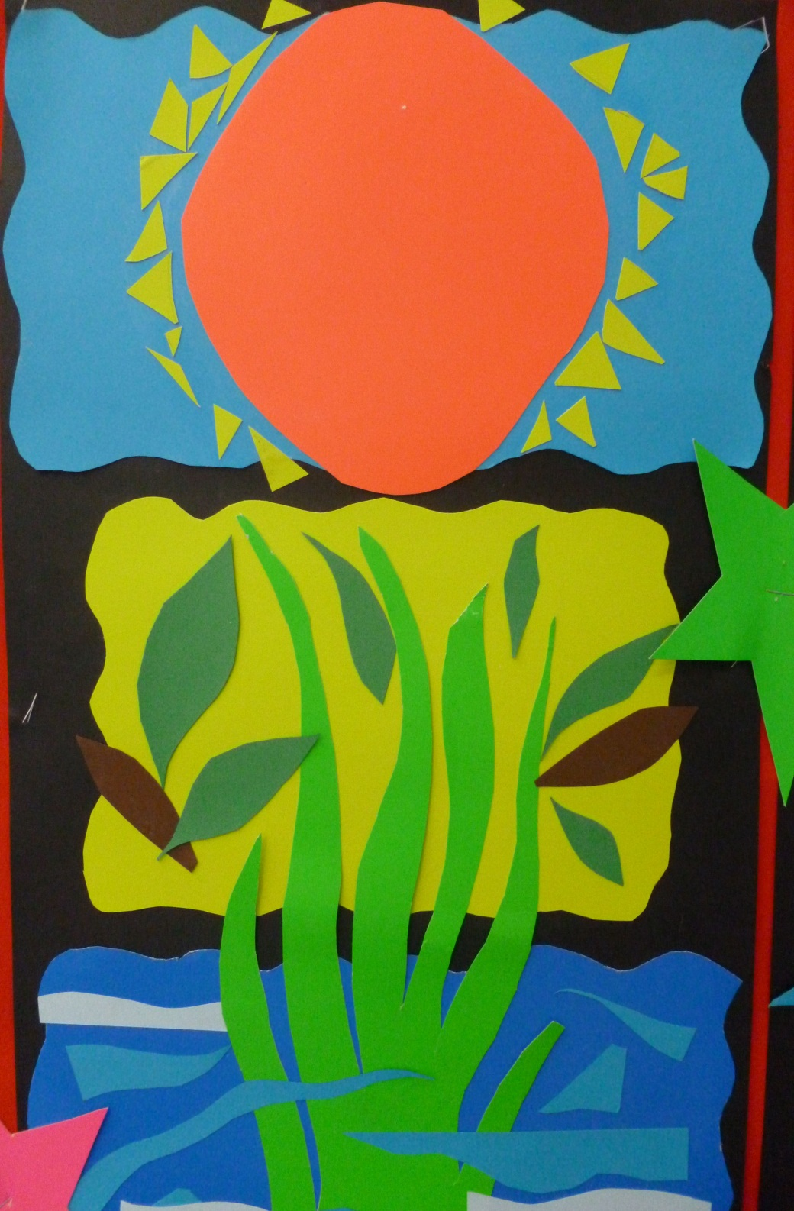
Nathaneal Paulson

Slide 8
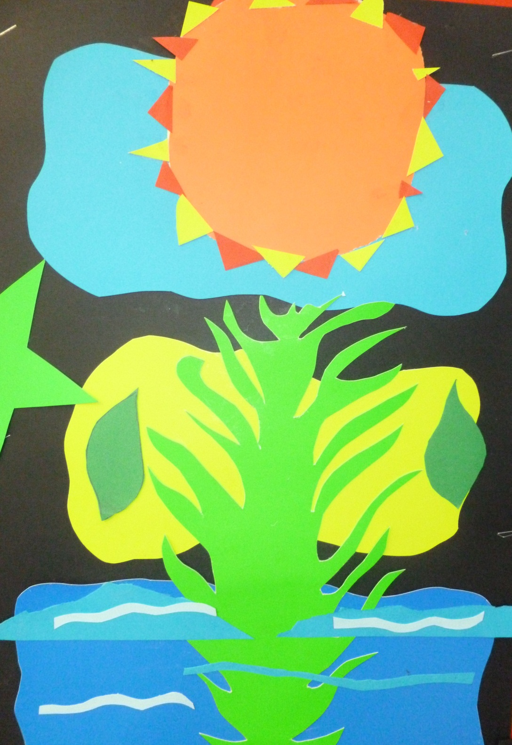
jarius

Slide 9
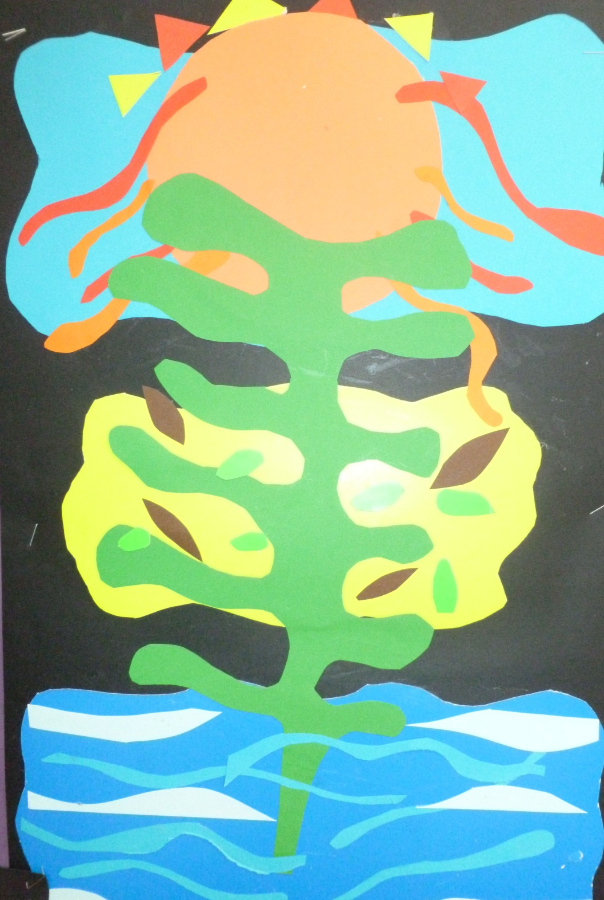
Jayden

Slide 10
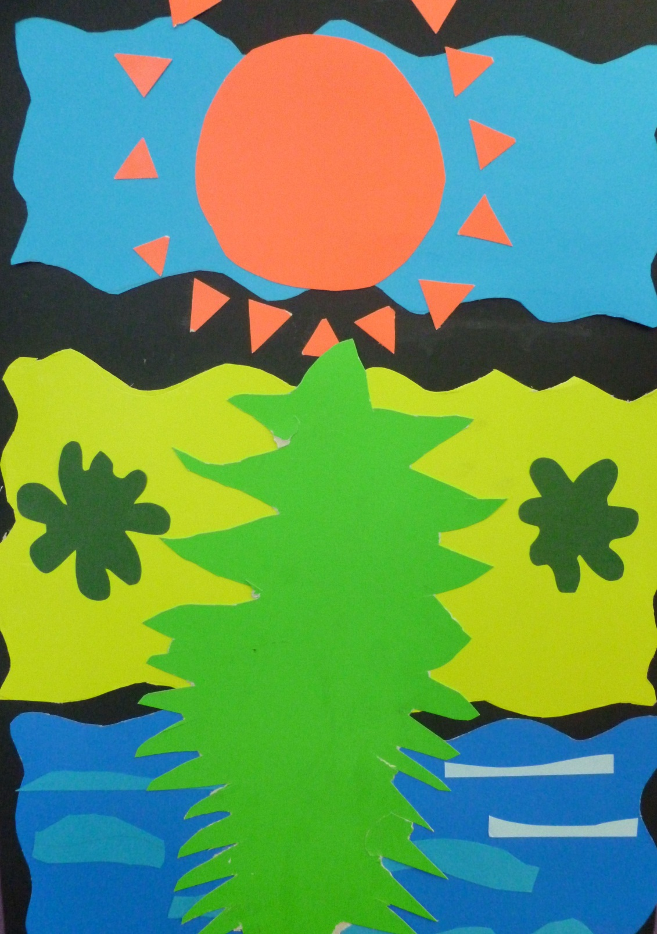
Jimmy

Slide 11
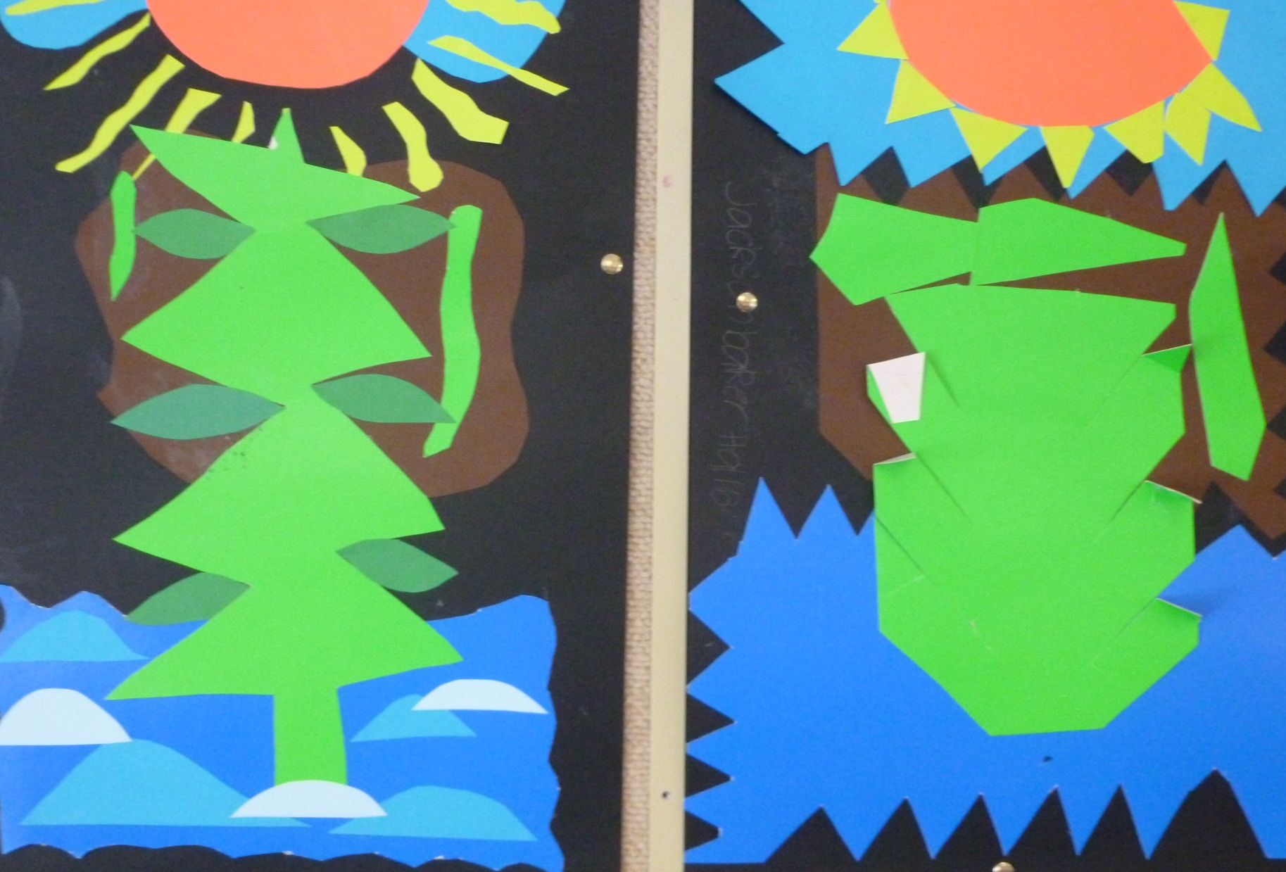
Lockie
Jackson

Slide 12
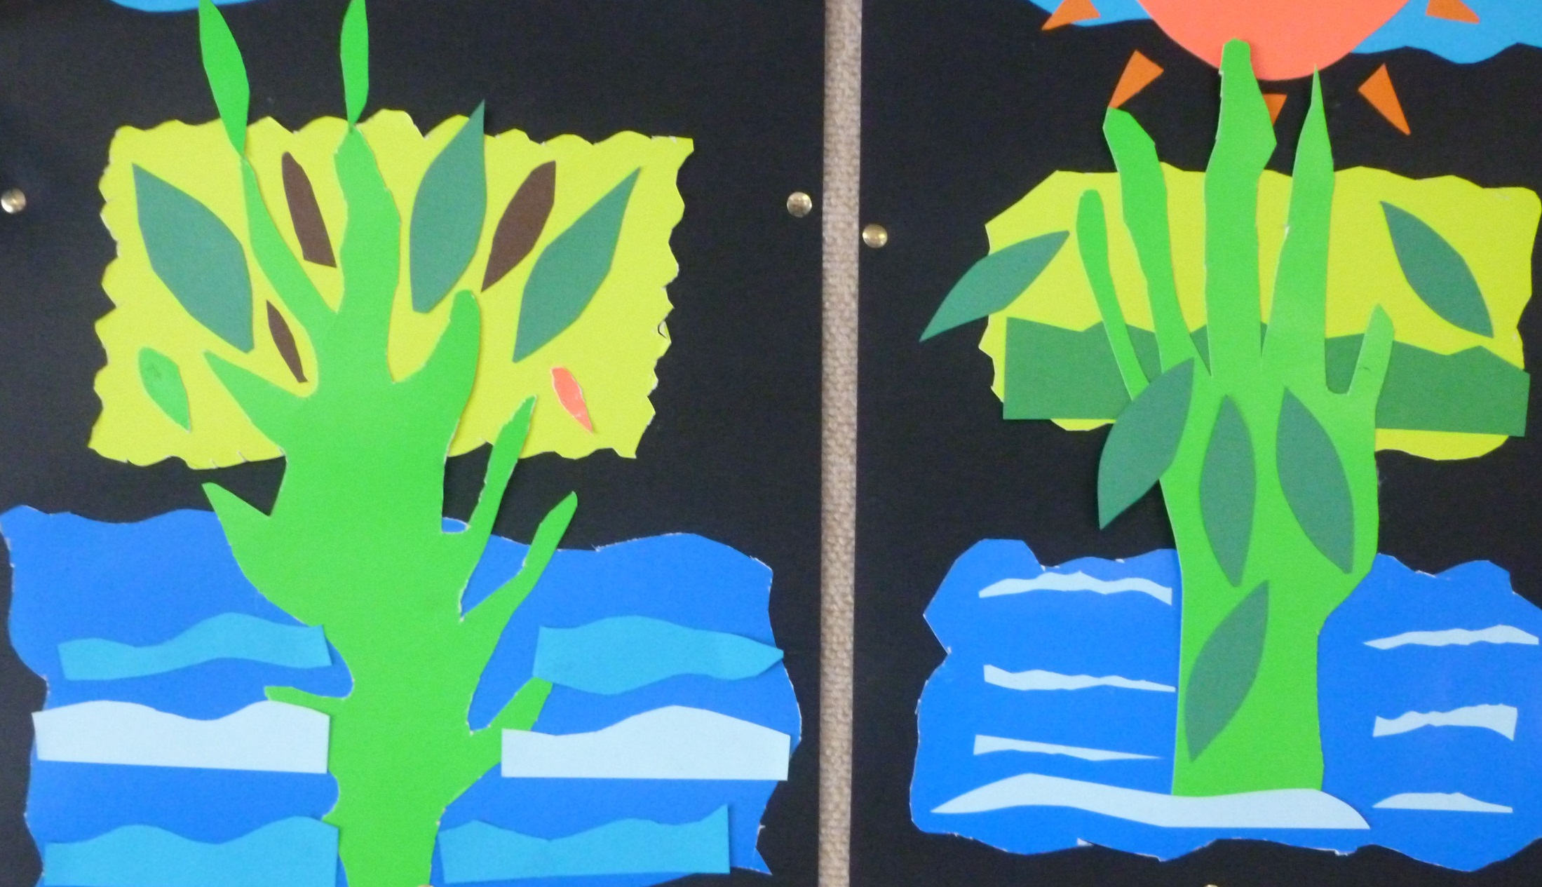
Tarny and Kimberly

Slide 13
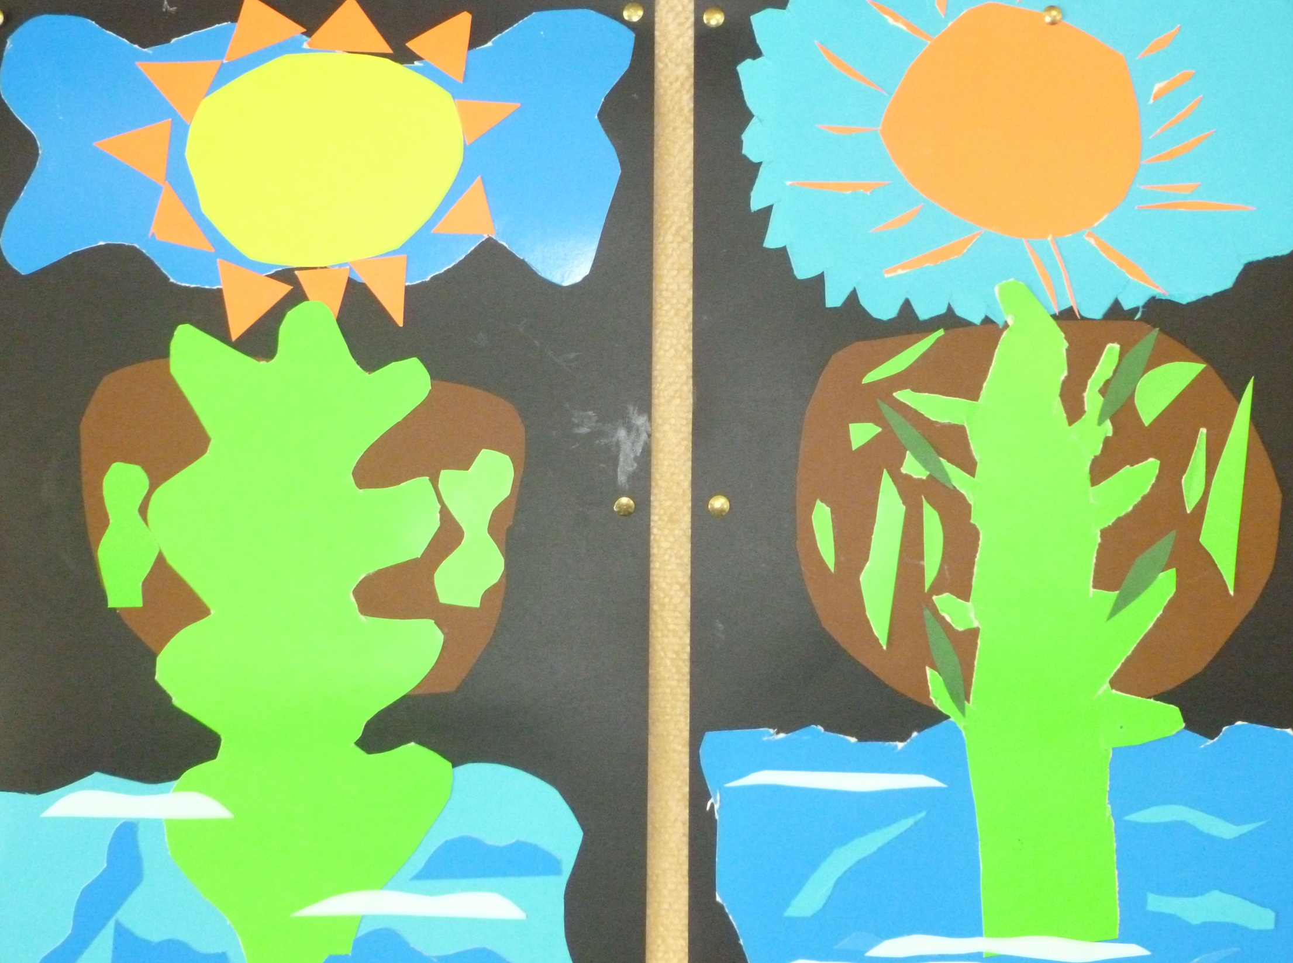
Zack and Dainton

Slide 14
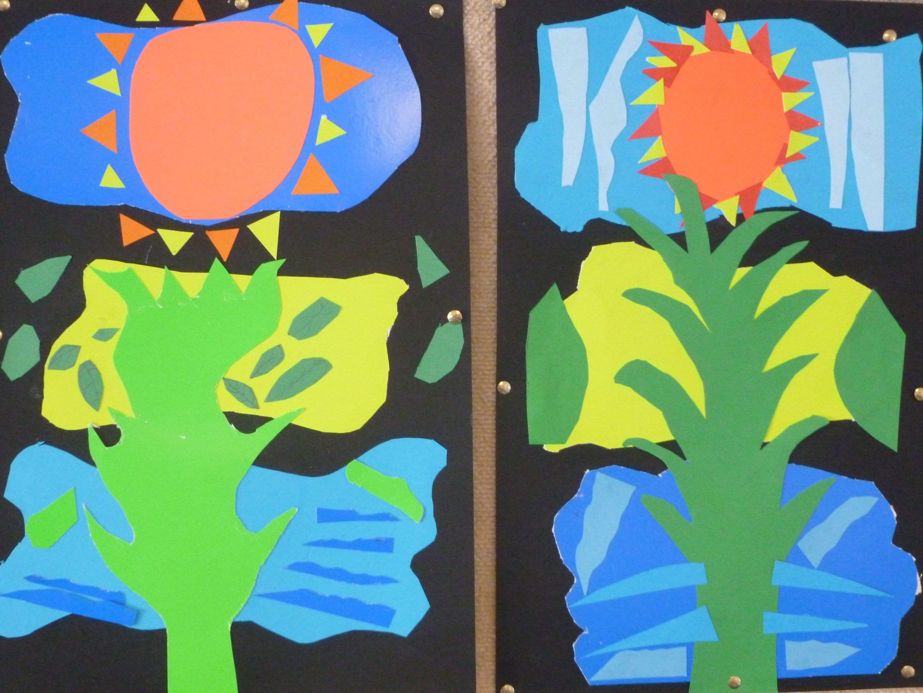
Warren and Noah

Slide 15
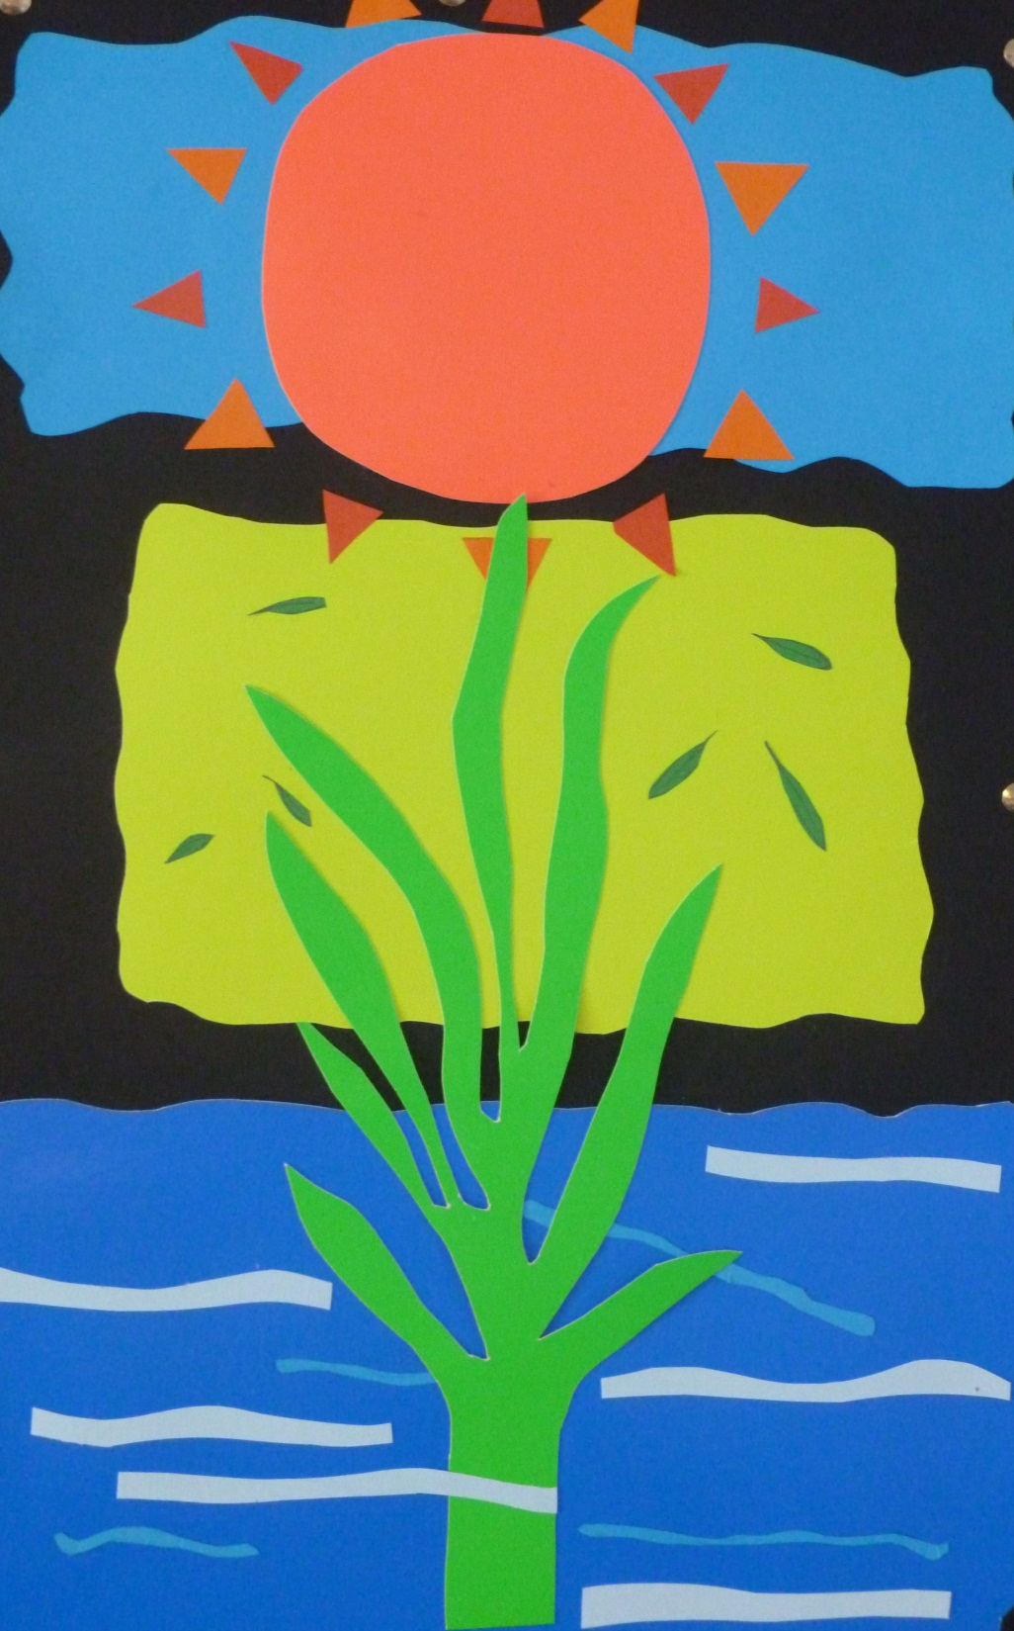
Jaymee

Slide 16
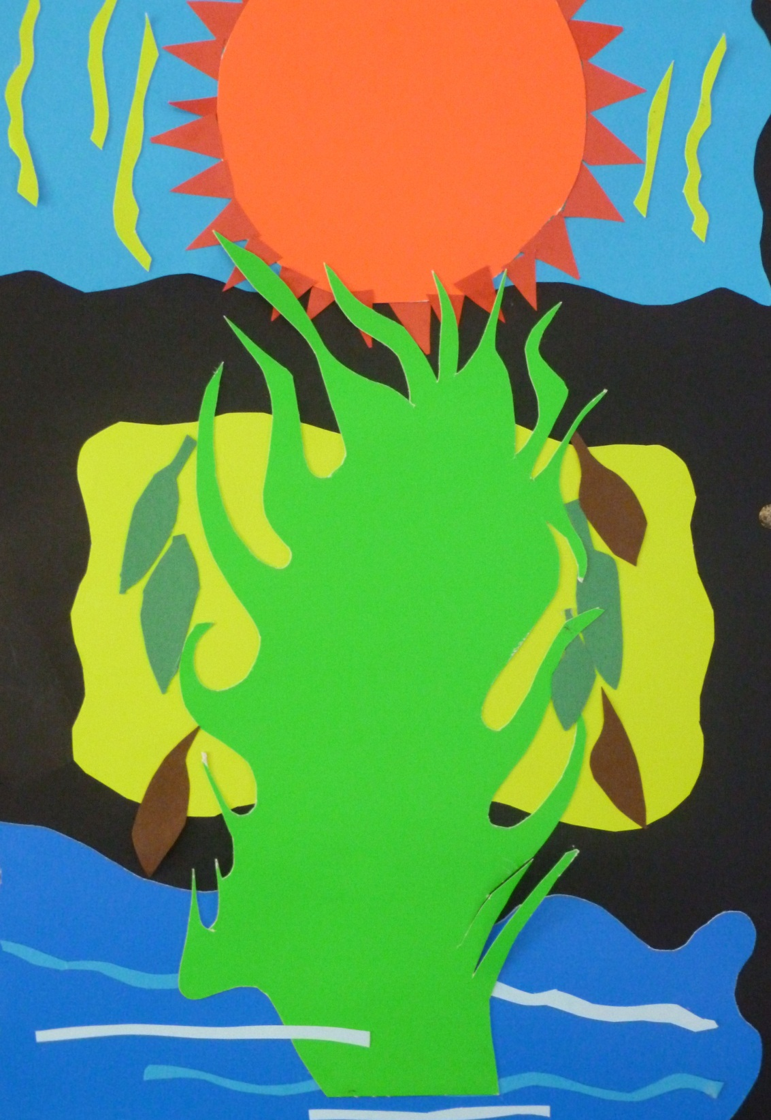
Caleb

