Slide 1
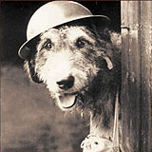
A Tribute to our animal heroes
ANZAC DAY 2015

Slide 2
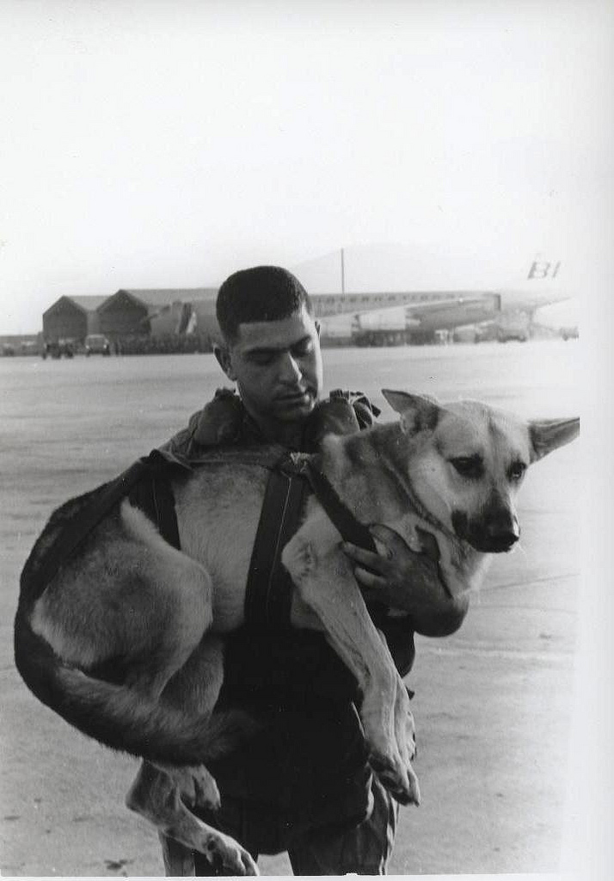
Dogs are used to carry messages, save people, detect bombs and as friends for soldiers.

Slide 3
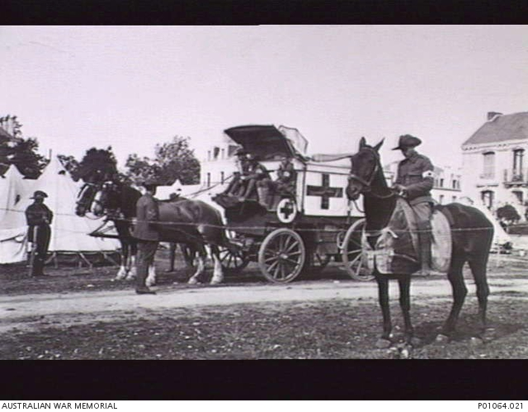
Horse Ambulances

Slide 4
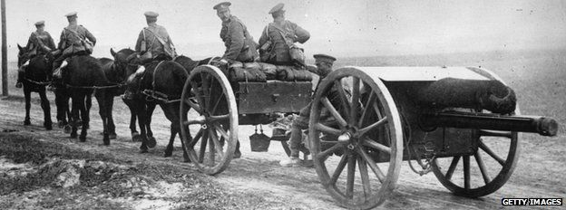
Gun carriages being pulled by horses in France during World War 1

Slide 5
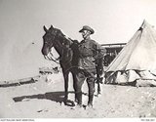
A SOLDIER with his horse IN EGYPT

Slide 6
Donkeys used for carrying supplies

Slide 7
monkeYs became pets in jungle warfare

Slide 8
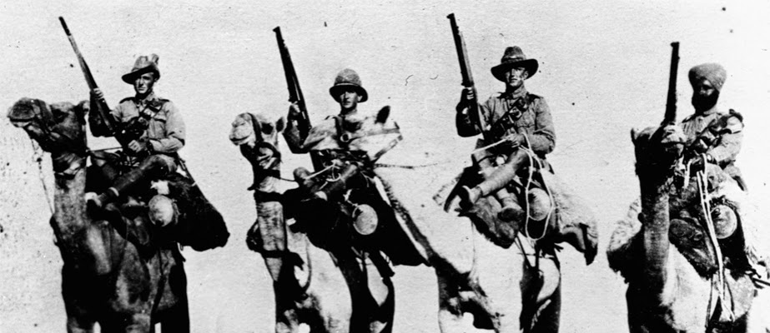
Soldiers from Australia, New Zealand, England and India using camels for transport

Slide 9
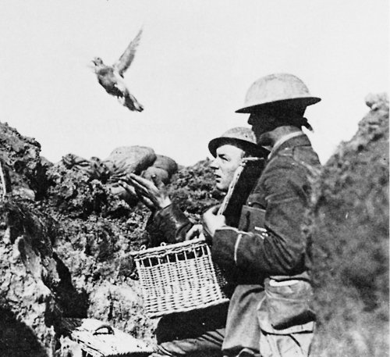
Pigeons were used to carry messages

Slide 10
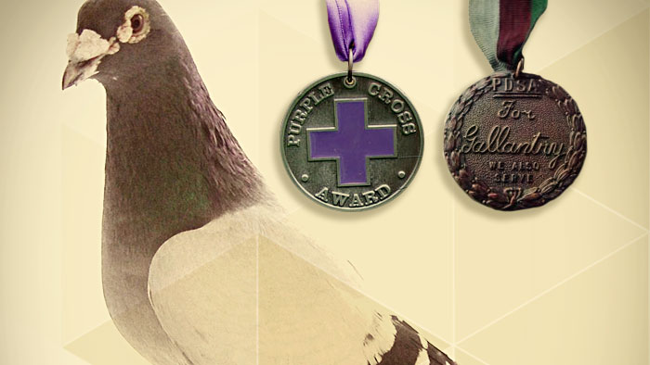
This pigeon even received medals for bravery

Slide 11
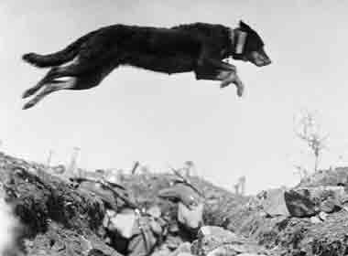
A very brave dog with a message attached to its collar leaping over trenches in World War 1

Slide 12
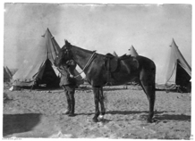
During World War 1 over 74,000 horses were sent overseas to help the Australian soldiers.
Only one horse returned to Australia.
His name was Sandy.

Slide 13
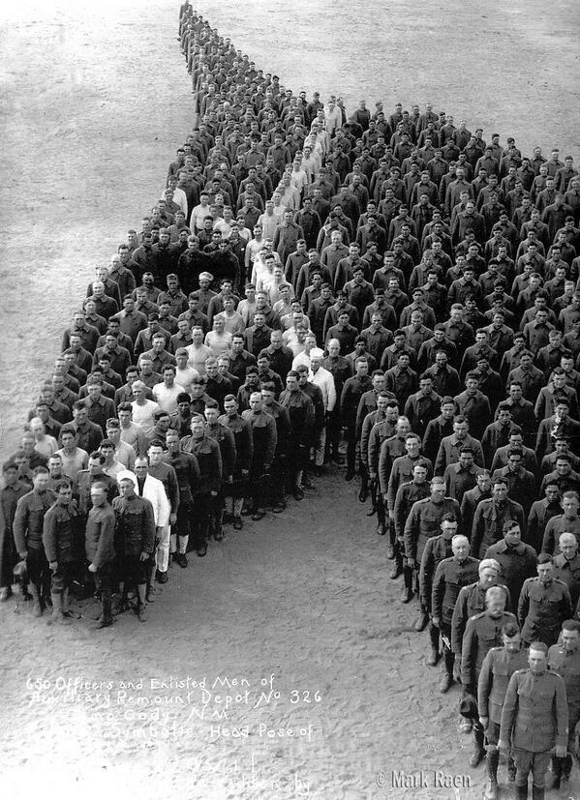
A tribute to horses by officers of the mounted division in England

Slide 14
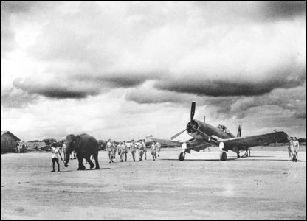
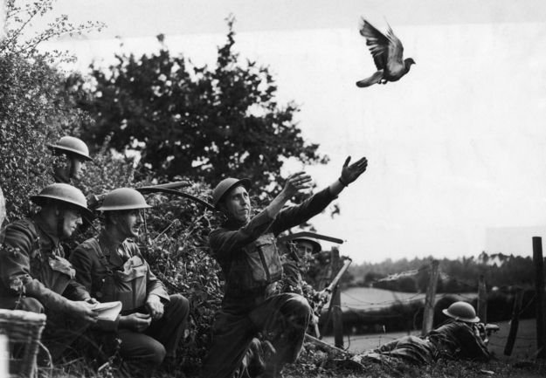
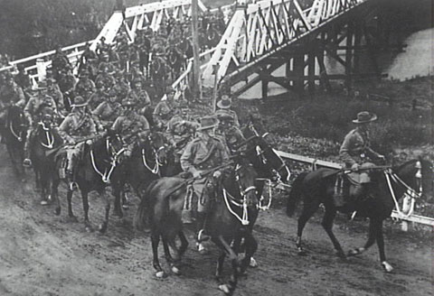
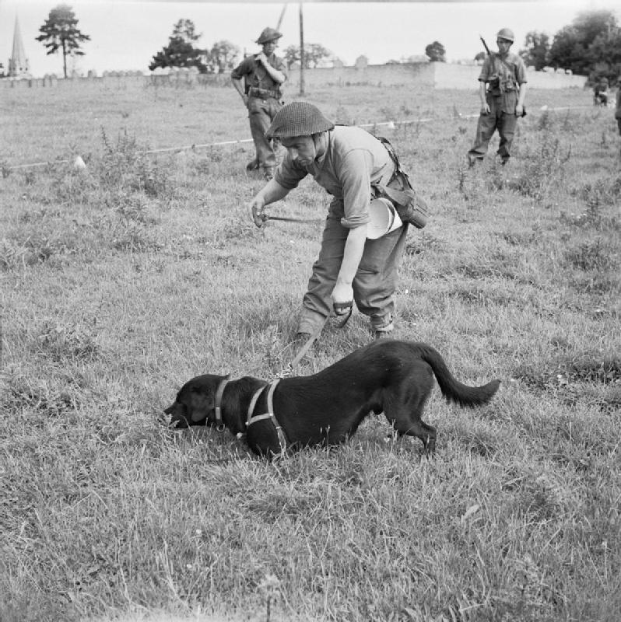
Some of the animals used in conflicts
Even an elephant !

Slide 15
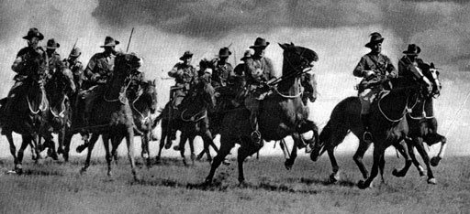
The charge of the Light Horse at Bersheeba was a very famous victory for Australian soldiers

Slide 16
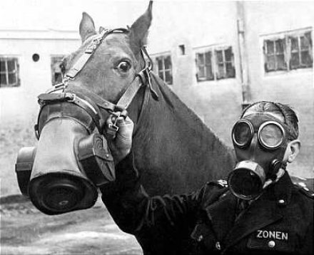
A horse and his handler wearing masks to protect them from gas

Slide 17
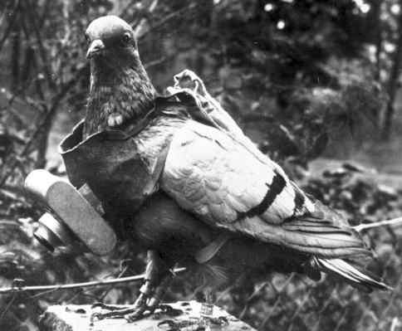
A pigeon being used to take photos from the air.

Slide 18
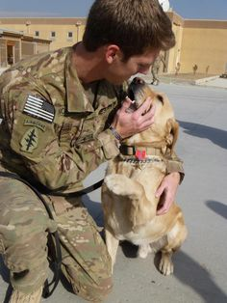
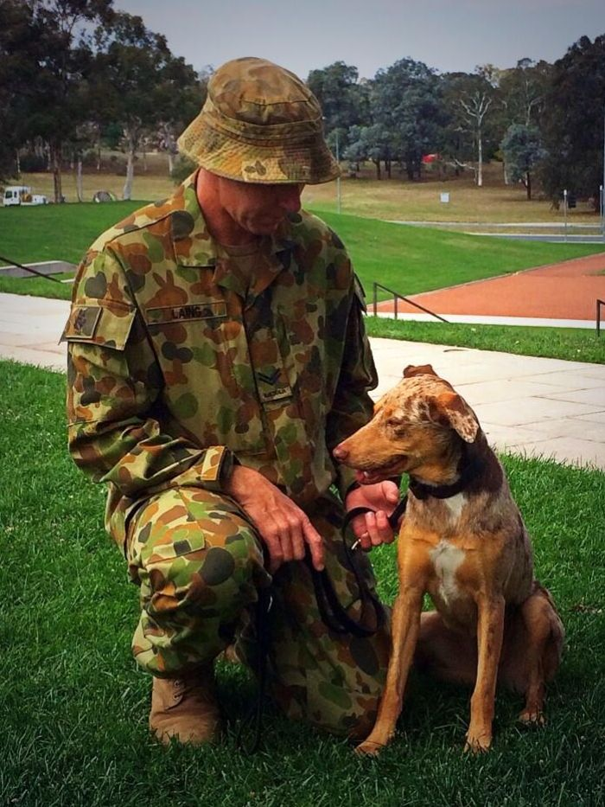
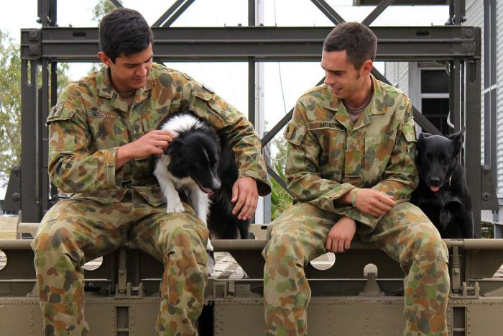
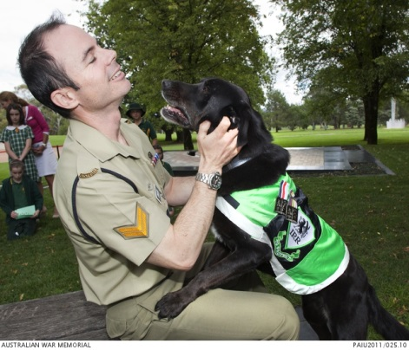
Dogs in the army become very close friends with the soldiers

Slide 19
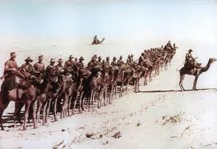
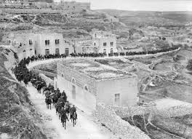
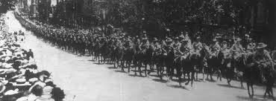

Slide 20
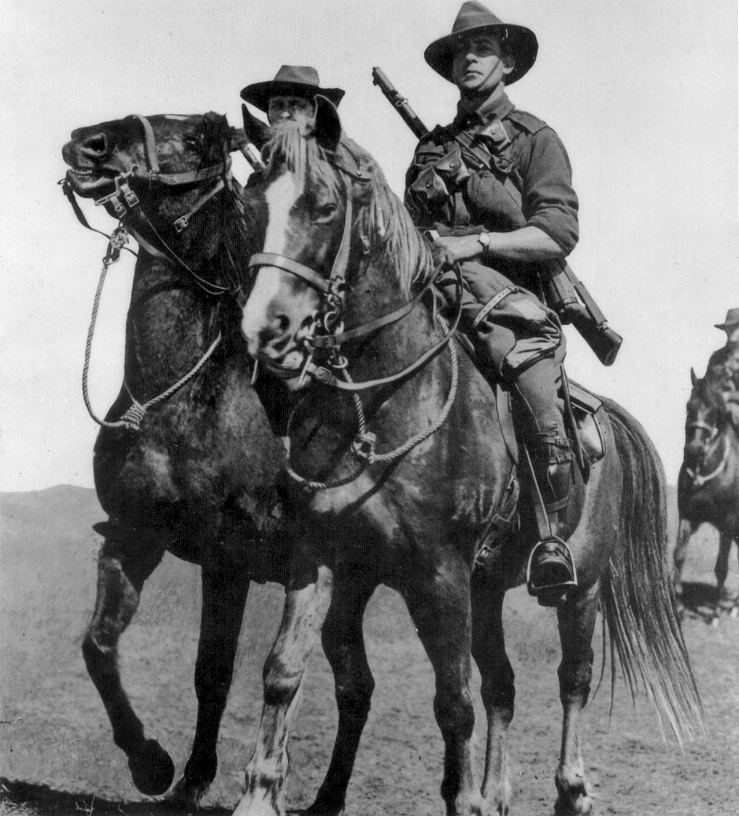
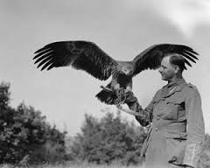
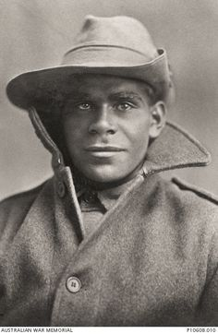
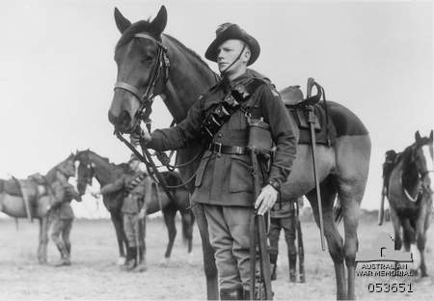
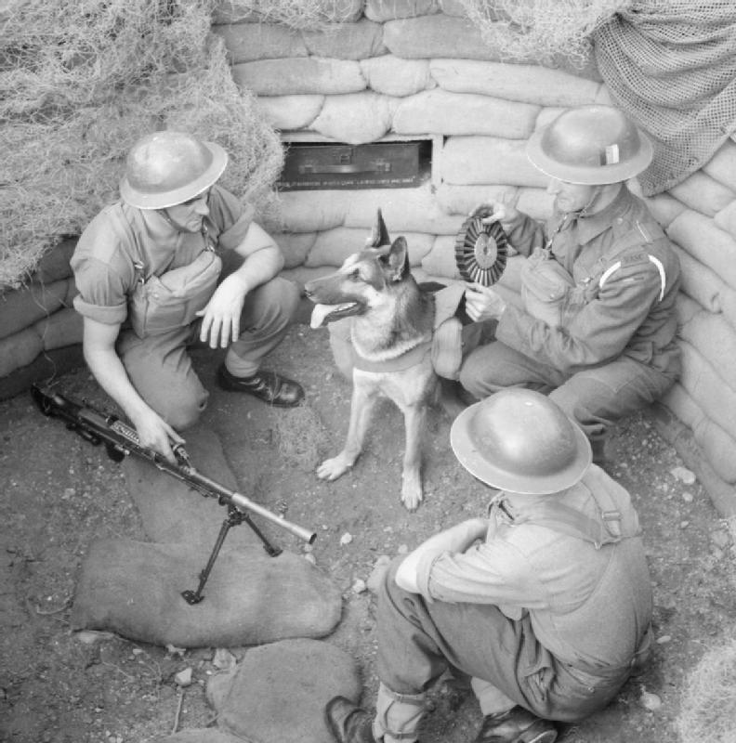
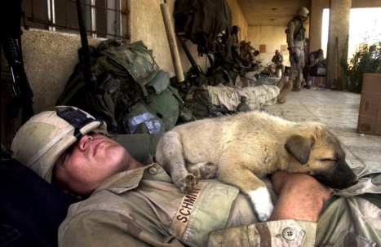
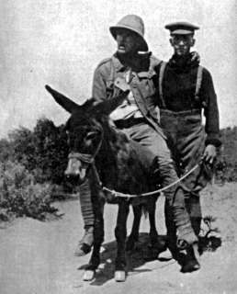
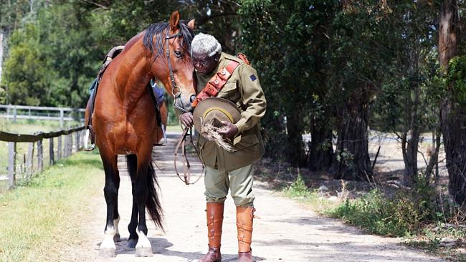
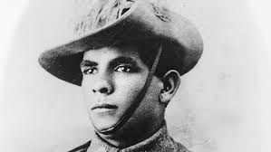

Slide 21
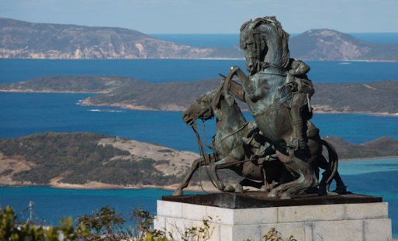
Memorial to Light Horseman in Albany, Western Australia

Slide 22
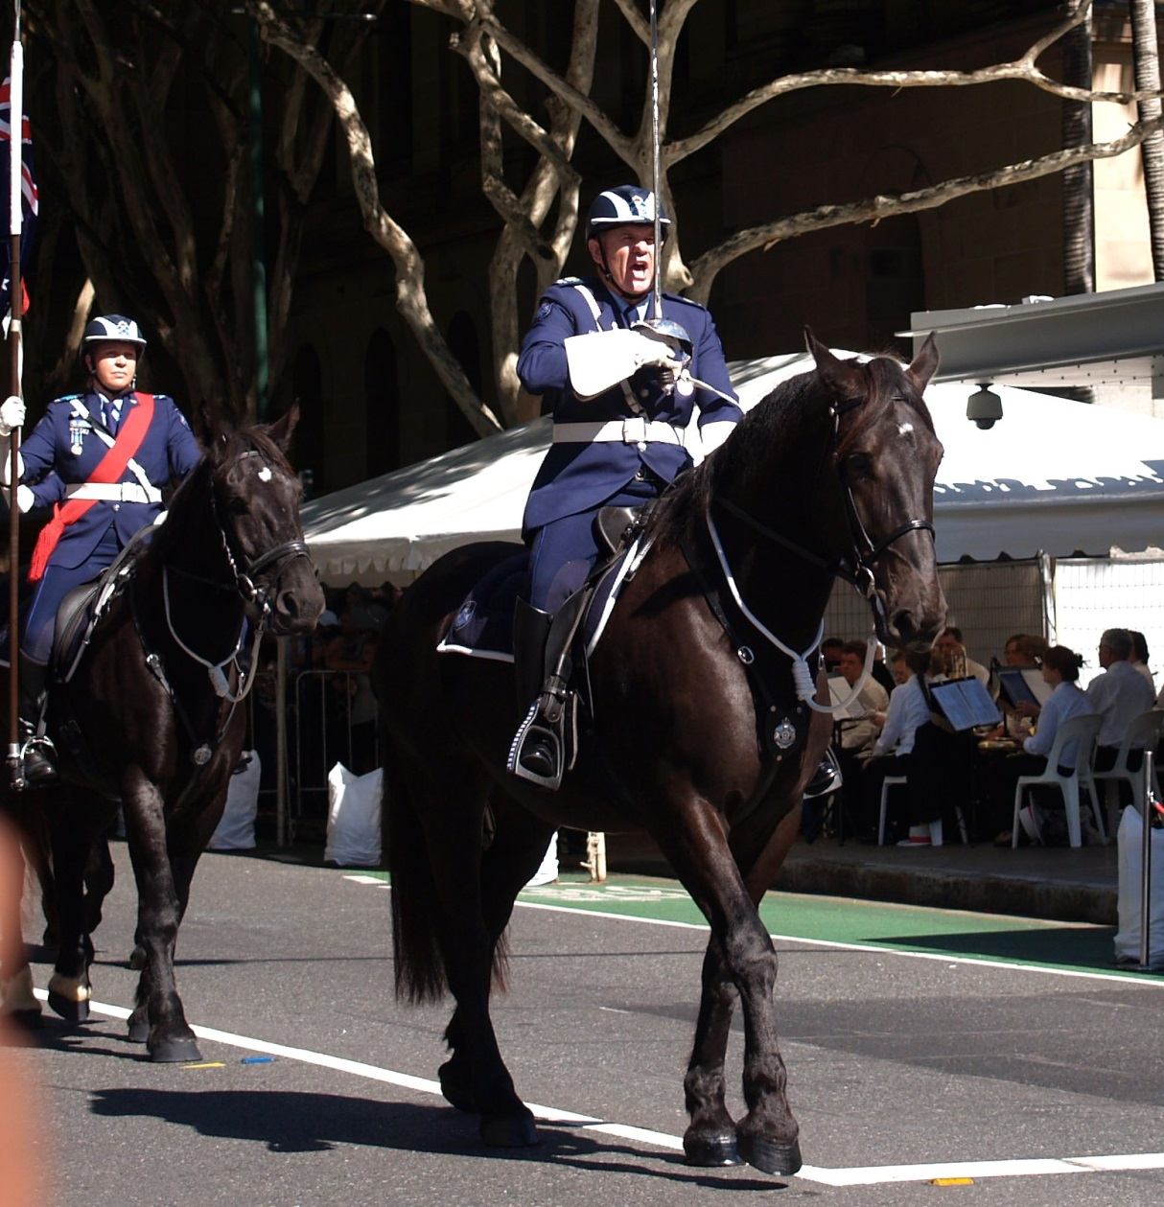
Horses being used in ANZAC parades

Slide 23
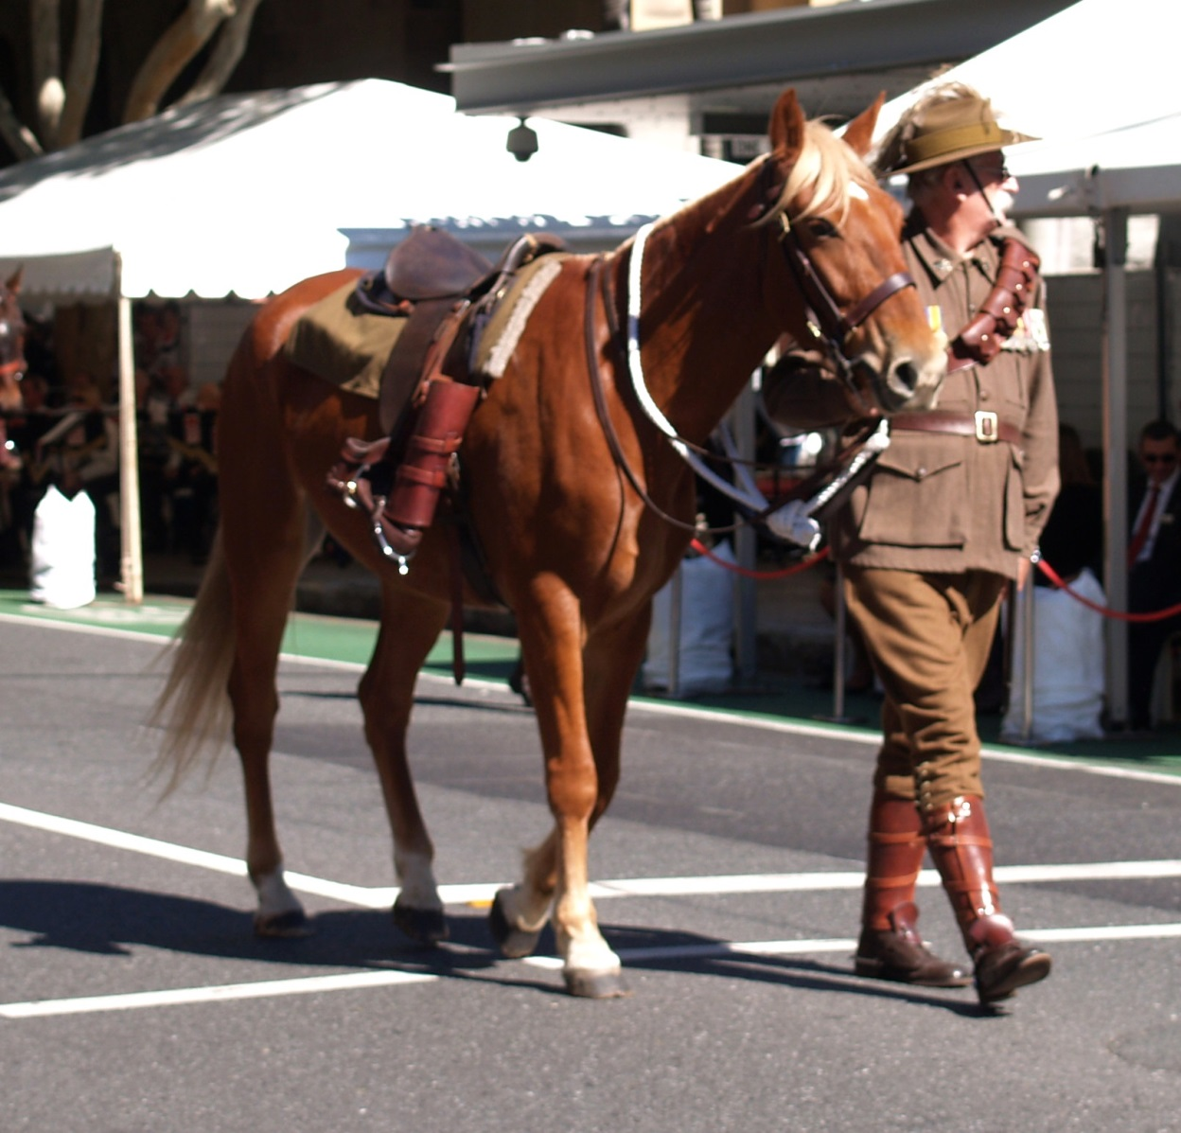
When a soldier dies his horse is paraded with the soldier’s boots turned backwards in the stirrups

Slide 24
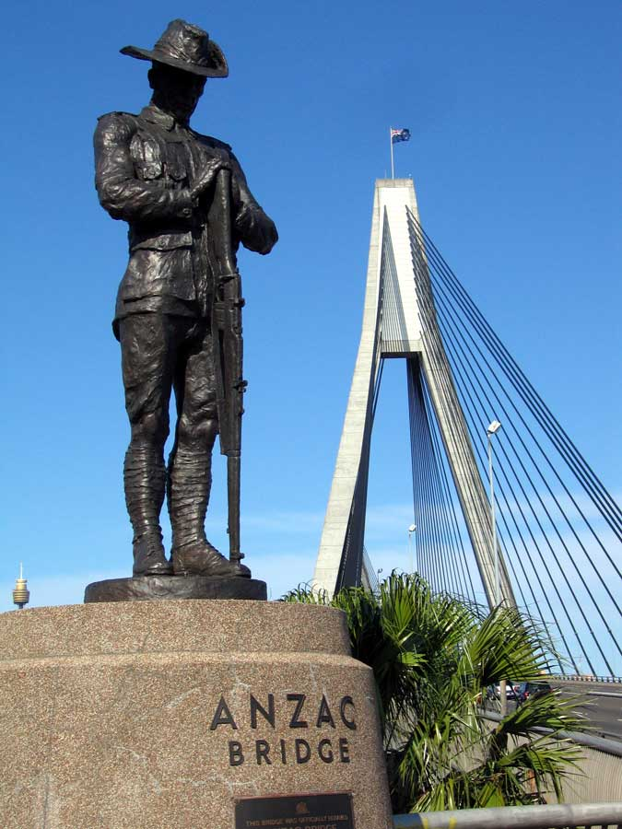
Lest We Forget

